Slide 1
Modern Hiring Systems, Recruiter Behavior, and Candidate Strategy
Exploring recruitment trends and effective job search methods
Notes:
AI-generated content may be incorrect. ---

Slide 2
Modern Hiring Foundations
Notes:
The Hiring Reality: Volume and Filtering, What an Applicant Tracking System (ATS) Actually Is, What Happens Before a Human Sees Your Resume

Slide 3

The Hiring Reality: Volume and Filtering
High Applicant Volume
Most job openings receive between 100 and 300+ applications, requiring rapid and efficient filtering to manage the volume.
Risk Management in Hiring
Hiring decisions prioritize identifying qualified and low-risk candidates to reduce organizational risk and ensure fairness.
Applicant Tracking Systems (ATS)
ATS technology organizes and filters applications using objective criteria, enabling recruiters to handle large volumes efficiently.
Candidate Strategy Reflection
Candidates should focus on clear qualifications, parse-friendly formatting, and alignment with employer needs to pass automated filters.
Notes:
The modern hiring landscape is defined by unprecedented applicant volume, with most open roles attracting between 100 and 300 or more applicants. This scale forces employers to prioritize efficiency, consistency, and legal safety when narrowing a large pool into a manageable shortlist. Because hiring represents a risk management decision rather than a discretionary favor, organizations must quickly identify candidates who appear both qualified and low‑risk. High volume also necessitates standardized processes to support compliance with equal employment regulations, documentation requirements, and internal fairness expectations. This context explains why filtering occurs rapidly and why many applications never receive human review. Systems and processes exist to handle scale while protecting the organization from both poor hiring choices and legal exposure. Transitioning into the next phase of the hiring funnel requires understanding the technology that structures the earliest steps of evaluation—specifically, Applicant Tracking Systems (ATS). These systems do not make decisions based on intuition; rather, they organize, sort, and retrieve data at scale, enabling recruiters to sift through vast numbers of applications efficiently. The reflection question tied to this stage encourages job seekers to reconsider common assumptions: many believe rejections result from personal judgments or human bias early in the process, when in reality the majority stem from automated filtering that enforces objective minimum criteria. Reflecting on this helps candidates shift from emotional interpretations toward strategic thinking—examining whether their materials clearly communicate required qualifications, use parse‑friendly formatting, and align with the employer’s specified needs.

Slide 4

What an Applicant Tracking System (ATS) Actually Is
Centralized Resume Database
ATS stores and organizes large numbers of resumes into searchable, structured data fields for easy access.
Automated Candidate Filtering
ATS applies automated rules to filter and rank candidates based on experience, certifications, and keywords.
Compliance and Documentation
ATS platforms help maintain hiring records to ensure compliance with employment laws and audit requirements.
Guiding Resume Creation
Understanding ATS helps applicants format resumes effectively using keywords and clear experience presentation.
Notes:
Applicant Tracking Systems (ATS) serve as centralized databases that support recruiters and hiring teams in organizing large applicant pools. These systems parse resumes into structured fields such as job titles, employment dates, skills, and educational background, transforming unstructured documents into searchable datasets. Once information is extracted, ATS tools allow hiring teams to filter, rank, and categorize candidates based on required or preferred qualifications. This includes applying automated rules—such as minimum years of experience, specific certifications, or keyword matches—that help reduce applicant volume quickly and consistently. In addition to filtering, ATS platforms support documentation for compliance audits, allowing organizations to maintain records of how hiring decisions were made. This is crucial for demonstrating adherence to equal employment opportunity guidelines and for defending against potential disputes. Importantly, ATS tools do not “think” or make subjective judgments; their function is to store, sort, and retrieve information accurately and consistently. Their utility lies in helping hiring teams manage scale while minimizing risk. For job seekers, understanding how these systems operate helps inform better resume construction—specifically the importance of conventional formatting, keyword alignment with job descriptions, and clarity in presenting experience. Without these elements, candidates may be filtered out before any human has an opportunity to evaluate their application.

Slide 5

What Happens Before a Human Sees Your Resume
Automated Resume Parsing
ATS software extracts key resume elements, structuring data for search and comparison to aid initial filtering.
Filtering Based on Job Requirements
Recruiters apply filters for certifications, experience, and qualifications to narrow down candidates effectively.
Ranking and Grouping Candidates
Systems rank applicants by keyword relevance and qualification scores before recruiter review begins.
Human Review of Shortlisted Resumes
Recruiters review top-ranked resumes after automated screening, focusing on the most qualified applicants.
Notes:
Before a recruiter ever reviews a resume, several technical filtering steps occur. First, the resume is parsed by the ATS, which extracts key elements such as job titles, skills, dates, and employer names, placing them into structured fields for search and comparison. If the formatting is unconventional—such as containing tables, graphics, or nonstandard columns—important data may be mistranslated or lost, reducing the likelihood of passing automated screens. Next, recruiters apply filters aligned with minimum job requirements. These may include specific certifications, degrees, prior job titles, or years of experience. Because large applicant pools often contain many who do not meet baseline requirements, filtering reduces the group to a manageable size. Systems then apply ranking or grouping mechanisms, such as keyword density, relevance scores, or qualification matching percentages. Only after these automated steps does a human typically enter the process. Recruiters generally review a small subset of applicants who survived initial screening, often focusing first on those ranked highest by the system. This explains why many applicants receive no direct response: their materials never progressed beyond automated parsing and filtering. Understanding this front‑end process changes candidate strategy significantly, highlighting the need for clarity, alignment with job requirements, and formatting that supports accurate system parsing.

Slide 6
Recruiter Behavior & Decision‑Making
Notes:
What Recruiters Actually Look At (Eye‑Tracking Study Findings), Signal Density: Why Titles and Dates Matter, Common Hiring Pitfalls and Human Bias Factors

Slide 7
What Recruiters Actually Look At (Eye‑Tracking Study Findings)
Recruiter Attention Focus
Recruiters spend about 6-7 seconds scanning resumes, focusing on names, job titles, employers, dates, and education.
Scanning Pattern
The typical scanning pattern moves from top left downward through titles and timelines, then across sections for details.
Importance of Visual Clarity
Clear formatting and concise information improve comprehension, while dense text and unclear layouts reduce professionalism.
Resume as Signal Sheet
Resumes act as structured signals rather than narratives, prioritizing core qualifications and alignment with job roles.
Notes:
Eye‑tracking research shows that recruiters spend approximately 6–7 seconds on an initial resume review, emphasizing the importance of visual clarity and signal strength. During this brief window, around 80% of their attention focuses on predictable elements: the candidate’s name and contact information, current job title, previous job titles, employer names, dates of employment, and educational background. These areas serve as high‑signal indicators that help recruiters rapidly assess relevance and risk. The scanning pattern typically follows a structured path—starting at the top left, moving down through titles and timelines, and then glancing across sections to identify anomalies or strengths. Because time is limited, dense text blocks, unclear formatting, or unconventional layouts hinder comprehension and may reduce perceived professionalism. This rapid‑scan behavior demonstrates that resumes function less as narratives and more as structured signal sheets. Candidates must therefore prioritize clarity, alignment with job requirements, and immediate visibility of core qualifications. The reflection question invites job seekers to consider what signals their resume conveys in just six seconds—whether their titles align with target roles, whether dates are clear, and whether the most important qualifications are easy to identify at a glance.

Slide 8

Signal Density: Why Titles and Dates Matter
Role of Job Titles
Job titles act as shorthand for experience level and seniority, aiding quick recruiter evaluation.
Importance of Employment Dates
Employment dates show continuity, growth, and reliability, with gaps raising concerns for recruiters.
Impact of Employer Brand
Well-known employer brands convey assumed rigor, while lesser-known companies need clearer context.
Clear Resume Formatting
Readable fonts and logical structure enhance information processing and signal clarity for recruiters.
Notes:
Job titles and employment dates act as compact, high‑density signals that help recruiters quickly evaluate whether a candidate meets baseline expectations. Titles function as shorthand indicators of experience level and capability; for example, the difference between "Coordinator," "Manager," and "Director" immediately conveys scope and seniority. Employer brand also influences perception—well‑known companies often benefit from assumed rigor, while lesser‑known organizations require clearer contextual explanation. Dates of employment matter because they convey continuity, growth, and reliability. Unexplained gaps or inconsistent timelines can raise concerns about risk, stability, or competence. Clear formatting further enhances cognitive processing; readable fonts, consistent spacing, and logical structure help recruiters extract key information efficiently. In competitive applicant pools, resumes with higher signal density—where titles, employers, and dates are easy to interpret—stand out more quickly. Understanding these dynamics helps candidates strategically highlight experiences that align with the target role, ensuring that high‑value signals are unmistakable within the recruiter’s brief review window.

Slide 9

Common Hiring Pitfalls and Human Bias Factors
Unstructured Interviews Increase Bias
Relying on subjective impressions raises variability and bias in hiring decisions.
Overweighting Surface Traits
Charisma, similarity, and confidence can wrongly influence hiring despite poor performance prediction.
Inconsistent Decision-Making Risks
Lack of standardized criteria causes unfair evaluations and increases organizational risk.
Benefits of Structured Processes
Standardized rubrics and clear criteria reduce bias, improve validity, and protect organizations legally.
Notes:
Research from institutions including Harvard Business School identifies several common pitfalls that affect hiring quality. Unstructured interviews, for example, increase both variability and bias because they rely heavily on subjective impressions rather than consistent evaluation criteria. Recruiters and hiring managers may also overweight surface cues such as charisma, similarity, or confidence, even though these traits are not reliable predictors of job performance. Another pitfall involves inconsistent or undocumented decision‑making, which compromises fairness and increases organizational risk. Without structured processes—such as standardized scoring rubrics, documented interview questions, and clear criteria—candidates may be evaluated differently depending on who interviews them or the order in which they are seen. These weaknesses highlight why structured hiring practices are essential: they reduce bias exposure, improve predictive validity, and protect the organization legally. Understanding these vulnerabilities helps job seekers interpret interviewer behavior and prepare strategically, anticipating the cues that influence decision‑making even when organizations aim for objectivity.

Slide 10
Risk, Bias, and Legal Structure in Hiring
Notes:
Why Organizations Adopt Structured Hiring Systems, AI in Hiring: Combining Human and Machine Judgment, Unconscious Bias in Hiring, Risk Reduction as the Core Hiring Driver

Slide 11

Why Organizations Adopt Structured Hiring Systems
Manage High Applicant Volume
Structured hiring systems streamline large applicant pools with filters and standardized workflows for efficiency.
Ensure Legal Compliance
Structured hiring documents decisions to meet equal employment regulations and reduce legal risks.
Consistent Evaluations
Standardized evaluations reduce bias and align assessments with role-specific job requirements.
Improved Transparency and Protection
Structured hiring offers transparency and protects organizations from discrimination claims by documenting processes.
Notes:
Organizations adopt structured hiring systems to manage high applicant volume, ensure legal compliance, and create consistent evaluation processes across teams. As applicant pools grow, especially in digital‑first job markets, manual review becomes impractical, making structured filters and standardized workflows essential. Legal compliance also plays a central role: equal employment regulations require documentation of decision‑making processes, making structured evaluations and audit trails indispensable. These systems provide transparency into how decisions were made, who reviewed which candidates, and whether the criteria were applied consistently. Standardization across hiring managers further reduces variability, ensuring that candidate assessments align with role‑specific requirements rather than personal preferences. Structured hiring not only improves efficiency but also protects organizations from claims of discrimination or unfair practices by demonstrating that decisions followed objective criteria. For job seekers, recognizing that structure is designed to manage risk and compliance—not to discourage candidates—helps reframe expectations and guides the creation of materials that align with organizational needs.

Slide 12

AI in Hiring: Combining Human and Machine Judgment
AI Supporting Recruitment Tasks
AI assists in resume screening, pattern detection, and candidate ranking, enhancing recruiter efficiency in early-stage hiring processes.
Human Decision-Making Importance
Human recruiters make final hiring decisions, especially in later interview stages and high-stakes evaluations.
Balancing Efficiency and Fairness
Ongoing concerns about AI fairness, bias, and explainability require continuous human oversight in hiring workflows.
Reflection on AI and Human Roles
Candidates are encouraged to consider where technology should support hiring and where human judgment is vital.
Notes:
Artificial intelligence plays an increasingly supportive role in hiring, assisting with pattern detection, resume screening, and candidate ranking. However, AI does not replace human decision‑makers; rather, it augments their capacity to process large volumes of information. Recruiters continue to make final decisions, particularly for later‑stage interviews and hiring outcomes. Trust in AI varies by task: organizations are generally more comfortable using automation for early‑stage filtering or administrative tasks, while high‑stakes decisions remain human‑led. AI tools aim to reduce workload, not replace evaluators. They help surface qualified candidates more quickly, flag potential misalignments, and impose consistency on initial screens. Nevertheless, concerns about fairness, explainability, and bias persist, requiring ongoing oversight. The reflection question associated with this topic asks candidates to consider where technology should support hiring processes and where uniquely human judgment is essential. This encourages applicants to think critically about the balance between efficiency and empathy within hiring workflows.

Slide 13

Unconscious Bias in Hiring
Common Types of Bias
Affinity bias, confirmation bias, and the halo effect commonly influence hiring decisions unconsciously.
Impact Despite Structure
Structured interviews and criteria reduce but do not completely eliminate unconscious bias in hiring.
Candidate Strategies
Candidates can reduce bias impact by highlighting qualifications and preparing clear explanations for gaps.
Empowerment Through Awareness
Awareness of bias enables candidates to navigate hiring systems strategically and understand decision contexts.
Notes:
Unconscious bias affects human decision‑making even within structured hiring systems. Common forms include affinity bias, in which recruiters favor candidates who resemble themselves; confirmation bias, in which decision‑makers seek information that supports existing assumptions; and the halo effect, in which one positive attribute influences overall perception. While organizations implement structured interviews and standardized criteria to minimize these effects, bias can still influence interpretation of signals such as communication style, employer prestige, or perceived cultural fit. Structured processes help reduce exposure to subjective factors, but they do not eliminate bias entirely. Understanding how bias manifests allows candidates to craft materials that highlight relevant qualifications clearly while reducing opportunities for subjective misinterpretation. Candidates can also anticipate areas where bias may arise—for example, by preparing concise explanations for employment gaps or emphasizing results rather than job titles. Awareness empowers job seekers to navigate the system more strategically while recognizing the broader context in which decisions are made.

Slide 14

Risk Reduction as the Core Hiring Driver
Hiring as Risk Management
Hiring focuses on minimizing costly mistakes that affect productivity and team dynamics in organizations.
Structured Interview Benefits
Standardized questions and scoring in interviews enable objective candidate comparisons and reduce bias.
Documentation and Accountability
Maintaining clear records supports legal defense and ensures transparency and accountability in hiring decisions.
Candidate Risk Reduction
Candidates reduce perceived risk by providing strong references, clear career narratives, and evidence-based achievements.
Notes:
At its core, hiring is a risk management exercise. Organizations aim to minimize the likelihood of making costly hiring mistakes—errors that can lead to lost productivity, team disruption, reputational harm, or legal exposure. Structured interviews help reduce these risks by standardizing questions and scoring, allowing managers to compare candidates objectively. Standardized evaluation frameworks create consistency, improve predictive accuracy, and reduce reliance on subjective impressions. Documentation also serves as a critical protective mechanism: maintaining clear records of decisions, criteria, and interview outcomes helps defend against legal challenges and ensures accountability. This emphasis on risk explains why organizations may appear conservative or slow-moving in hiring processes—they prioritize caution over speed. For candidates, recognizing risk as a motivator helps explain why clarity, professionalism, and consistency are essential. Strategically, job seekers benefit from reducing perceived risk through strong references, clear narratives of career progression, and evidence‑based accomplishments.

Slide 15
Signaling Theory & Candidate Strategy
Notes:
What Is Signaling Theory?, Signals Candidates Send, Signals Employers Send

Slide 16
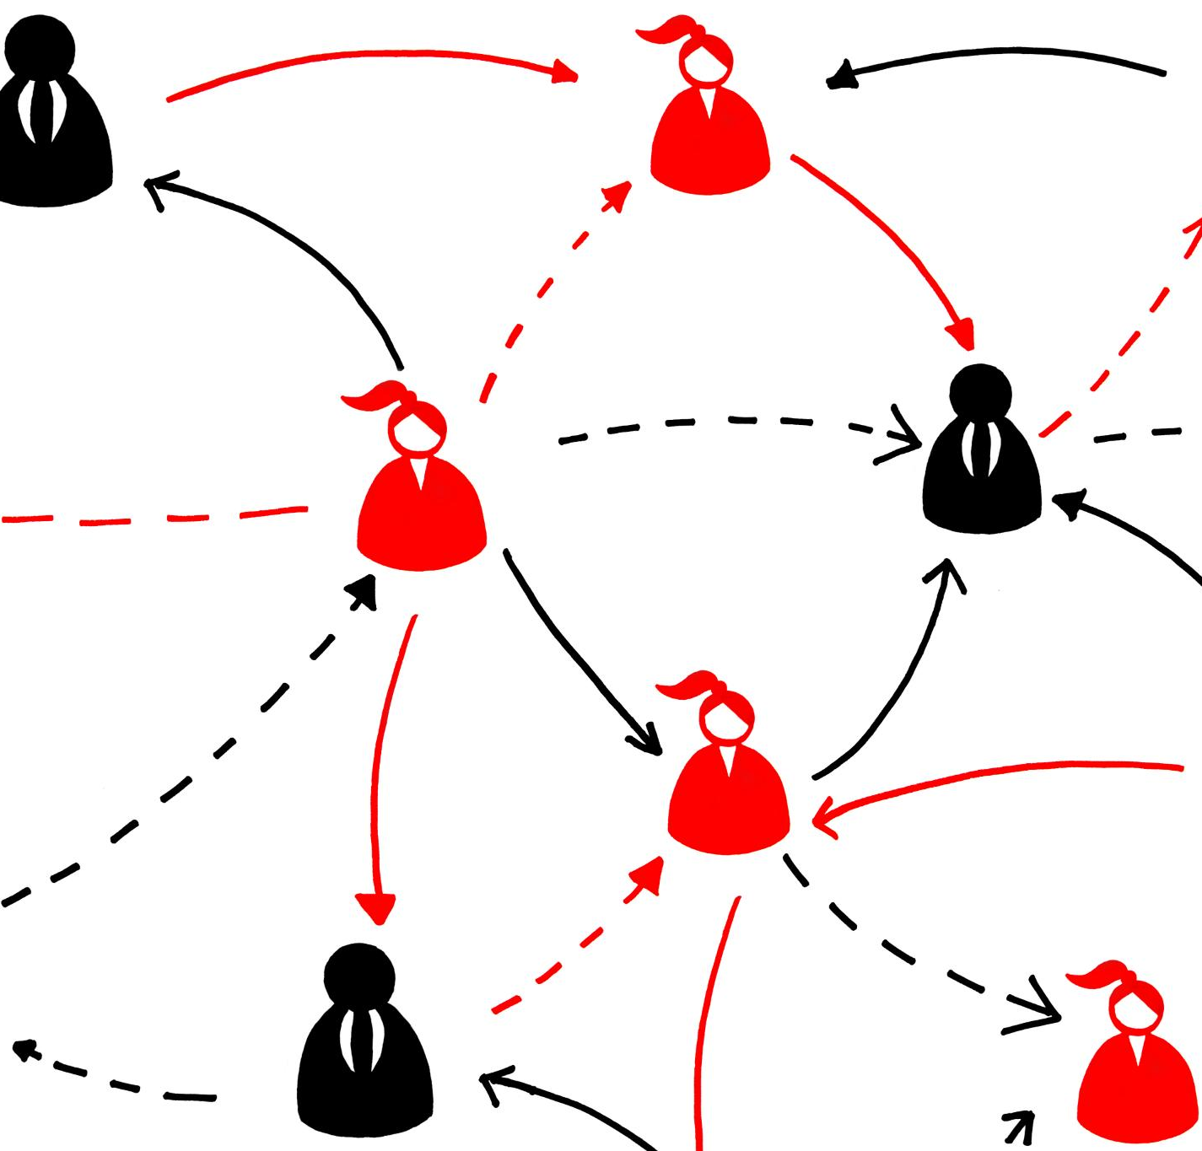
What Is Signaling Theory?
Signaling in Hiring
Employers and candidates use signals to evaluate value, fit, and risk during hiring due to limited information.
Candidate Signals
Candidates send signals through resumes, cover letters, communication style, timing, and response speed.
Employer Signals
Employers signal professionalism and culture via process transparency, responsiveness, and interview structure.
Impact of Signal Perception
Signal framing and perception heavily influence hiring decisions, making small choices important for candidates.
Notes:
Signaling theory provides a useful framework for understanding hiring interactions. Because employers and candidates have limited information about one another, each side interprets signals to assess value, fit, and risk. Candidates send signals through their resumes, cover letters, communication style, timing, and even response speed. These signals help employers infer capability, reliability, and motivation. Employers also send signals—such as process transparency, responsiveness, interview structure, and communication quality—that candidates interpret in terms of organizational professionalism and culture. Signaling theory recognizes that neither side has perfect information, so decisions rely heavily on how signals are framed and perceived. For job seekers, this means that seemingly small choices—such as resume formatting or follow‑up timing—can influence outcomes more than expected. Understanding this helps candidates become more intentional about how they represent their experience and professionalism throughout the entire hiring process.

Slide 17

Signals Candidates Send
Resume Clarity and Alignment
Clear and aligned resumes show professionalism, attention to detail, and suitability for the role.
Responsive Communication
Prompt and polite responses during scheduling demonstrate reliability and good interpersonal skills.
Employment Continuity Signals
Consistent employment or clear gap explanations signal stability and reduce hiring risk.
Customized Applications
Tailoring applications for each job role reflects genuine interest and distinguishes candidates from others.
Notes:
Candidates communicate numerous intentional and unintentional signals throughout the hiring process. Resume clarity and alignment with the job description indicate professionalism, attention to detail, and role fit. Prompt, polite responsiveness during scheduling demonstrates reliability. Employment continuity—or clear explanations of gaps—signals stability and reduces perceived risk. Customizing applications for each role shows effort and genuine interest, distinguishing applicants from those submitting generic materials. Even small elements, such as consistent formatting, grammar accuracy, and appropriately structured email communication, contribute to a candidate’s overall signal profile. Because employers must make decisions with imperfect information, these signals play an outsized role in shaping perceptions during early and mid‑stage evaluations.

Slide 18

Signals Employers Send
Response Speed Signals
Fast responses indicate efficiency, while delays can suggest decision-making bottlenecks.
Transparent Processes
Sharing interview steps upfront signals professionalism and respect for candidates’ time.
Structured vs Disorganized Interviews
Structured interviews convey fairness; disorganized interactions hint at internal misalignment.
Communication Quality Impact
Clarity, timeliness, and tone influence candidate perceptions of culture and leadership.
Notes:
Employers also send signals that shape candidate expectations and interpretations. Speed of response may suggest organizational efficiency or, conversely, bottlenecks in decision‑making. Transparent processes—such as sharing interview steps upfront—signal professionalism and respect for candidates’ time. Structured interviews convey fairness and consistency, while disorganized interactions can indicate internal misalignment. Communication quality, including clarity, timeliness, and tone, influences how candidates perceive culture and leadership. The reflection question urges job seekers to consider the signals they themselves may be sending unintentionally, emphasizing that signaling is continuous and two‑directional. Understanding employer signals helps candidates interpret timelines, assess organizational quality, and navigate next steps with greater confidence.

Slide 19
Strategic Implications for Job Seekers
Notes:
Designing a Resume for Systems and Humans, Final Takeaways: Navigating Modern Hiring

Slide 20

Designing a Resume for Systems and Humans
Clear Formatting for ATS
Use conventional formatting to ensure Applicant Tracking Systems accurately parse resume content and prevent data loss.
Qualification Alignment
Mirror job description qualifications in the resume to improve alignment during automated filtering.
Prioritizing Key Sections
Emphasize job titles, employer names, and dates to facilitate quick relevance identification by systems and humans.
Balancing Clarity and Impact
Focus on achievements with measurable outcomes while maintaining structural simplicity for easy review.
Notes:
A strategically designed resume must satisfy both Applicant Tracking Systems and human reviewers. Clear, conventional formatting ensures accurate parsing, preventing important information from being lost or misinterpreted. Mirroring required qualifications from job descriptions increases alignment during automated filtering. Prioritizing high‑signal sections—such as job titles, employer names, and dates of employment—helps both systems and humans quickly identify relevance. Avoiding graphics, text boxes, or decorative elements supports cleaner parsing and improves cognitive processing for recruiters performing rapid scans. Effective resumes balance clarity and impact, emphasizing achievements with quantifiable outcomes while maintaining structural simplicity. By optimizing for both technical and human audiences, candidates significantly improve their likelihood of advancing through early funnel stages.

Slide 21

Final Takeaways: Navigating Modern Hiring
Purpose of Modern Hiring
Modern hiring manages volume, reduces risk, and ensures fairness, aiming to facilitate, not discourage, applicants.
Role of ATS and Recruiters
Applicant Tracking Systems organize data, but human recruiters make final candidate decisions.
Importance of High-Signal Indicators
Candidates should emphasize strong indicators in resumes to quickly communicate capabilities during brief recruiter scans.
Structured Hiring Benefits
Structured hiring reduces bias, improves evaluation consistency, and legally protects organizations.
Notes:
Modern hiring processes are built to manage volume, reduce risk, and ensure fairness, not to discourage applicants. ATS platforms organize applicant data, but human recruiters ultimately make decisions. Because recruiters spend only a few seconds scanning resumes initially, candidates benefit from emphasizing high‑signal indicators that communicate capability quickly. Structured hiring practices exist to reduce bias exposure, improve evaluation consistency, and protect organizations legally. Candidates who understand these systems are better equipped to position themselves strategically—crafting resumes that meet both system and human needs, preparing for structured interviews, and managing the signals they send throughout the process. The final reflection question encourages job seekers to consider how this understanding will inform future application strategies, prompting a shift from reactive job searching to intentional, high‑signal positioning.

